Slide 1
JVM Architecture

Slide 2
Java to JVM
Java Source File
(.java)
Java Compiler
(javac)
JVM
[Class Loader Subsystem]
Java Class File / Byte Code
(.class)

Slide 3
Architecture
Class Loader Subsystem
Various Memory Areas
Execution Engine

Slide 4
Class Loader Subsystem
Loading
Linking
Initialization
Bootstrap Class Loader
Verify
Extension Class Loader
Prepare
Initialization
Application Class Loader
Resolve

Slide 5
Class Loader Subsystem
Loading:
Bootstrap Class Loader : Responsible to load classes from Bootstrap Class Path which is nothing but the rt.jar file which contains all core java APIs. It has highest priority.
Extension Class Loader : Responsible for loading the classes which are present inside ext folder (jre/lib/ext).
Application Class Loader : Responsible for loading the classes from application level Class Path which is nothing but the environment variable Class Path.
Linking:
Verify : It verifies the generated byte code, is it proper or nor; is it generated by a valid compiler or not; is it a virus or not; which makes it secure. If verification fails then it gives verify error.
Prepare : Memory is allocated to static variables and they are assigned to default value (0).
Resolve : All symbolic references are replaced with original references from Method Area.
Initialization :
Initialization : static variables are assigned to their original value and static blocks get executed.

Slide 6
Memory Areas
Method Area
Object Data
Stack Area
PC Register for t1
Native Method Stack
Class Data
PC Register for t1
Object Data
t1
t2
tn
t1
t2
tn
PC Register for tn
Class Data
Heap Area
PC Registers
t1
* t = Thread
= Thread

Slide 7
Memory Areas
Method Area : Contains class level data including static variables.
Heap Area : Contains object data and the corresponding instance variables.
* For every JVM only one Method Area and one Heap Area are there.
* Since Method Area and Heap Area are shared with other threads, it is not thread safe.
Stack Area : For every thread a separate runtime stack is created inside JVM. All local variables are created inside Stack memory. For every method call, one entry is stored in the stack memory, that entry is considered as Stack Frame which contains three parts (Local Variable Array, which contains all the local variables and their corresponding values for that particular method; Operand Stack, which performs intermediate operation; Frame Data, which contains all symbols used in that method and also contains catch block information in case of Exception). Data inside Stack Area is always thread safe because a separate runtime stack is created for a particular thread and the data is available to that thread only.
PC Registers : For every thread one PC Register is created to hold the address of next executing instruction.
Native Method Stack : It holds the native method information.

Slide 8
Execution Engine
JIT Compiler
Intermediate Code Generator
Java Native Interface (JNI)
Native Method Libraries
Interpreter
Code Optimizer
Profiler
GC
Target Code Generator
Machine Code / Native Code
Execution Engine

Slide 9
Execution Engine
Interpreter : Responsible to read, interpret and execute java program line by line. Every java program must be interpreted at least once.
Profiler : It identifies repeatedly required methods or hotspot methods.
JIT Compiler : It is applicable for repeatedly required methods only, not for every method.
Intermediate Code Generator : Generates intermediate code.
Code Optimizer : Optimizes the generated code.
Target Code Generator : Generates machine code or native code.
GC : Garbage Collector, removes the unnecessary data from memory.
JNI : While executing a java program, the execution engine sometimes may require native method information. JNI interacts with the Native Method Libraries and provides that information through JNI to the execution engine.

Slide 10
Complete JVM Architecture
Loading
Linking
Initialization
Method Area
Heap Area
Stack Area
PC Register
Native Method Stack
Java Native Interface
(JNI)
Garbage
Collector
Native Method Libraries
Interpreter
JIT Compiler

Slide 11
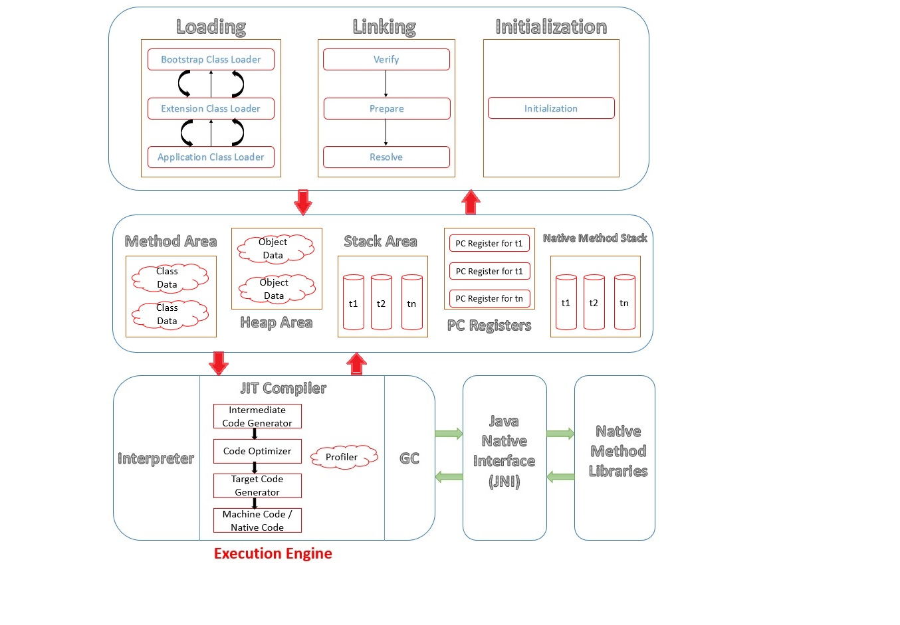

Slide 12
Thank You

